Slide 1
FRC Command Based Robot Programming
Eric Haas
Programing Mentor, team 4241
February 2021

Slide 2
Presentation Objective
Explore the FRC C++ command based robot framework.
Understand the recommended way for subsystems and commands to interact with each other in the code through objects and functions.
This presentation in not a general introduction to the C++ language.
This presentation is not an overview of object oriented programming principles (things like separate the interface from the implementation).

Slide 3
Functional vs. Object Oriented Example
Imagine a simple robot with a tank drive.
When you start the robot, it goes forward at full speed.
While you hold down the button on the controller, speed is reduced to 50%.

Slide 4
Functional
Is the button pushed down?
Yes
Run motors half speed.
No
Run motors full speed.

Slide 5
Object Oriented
Command Scheduler Object
Is the button pushed down?
Cancel default command. Schedule ‘drive forward 50% speed’ with the drivetrain subsystem.
Yes
Robot Container Object
No
No commands need the drivetrain subsystem, schedule default command ‘drive forward 100% speed’
Robot Container Object
The Drivetrain Subsystem, 100% speed
The Drivetrain Subsystem, 50% speed
Command Object
Tell a drivetrain subsystem to drive forward as the requested speed
Tell a drivetrain subsystem to drive forward as the requested speed
Command Object
The Drivetrain Subsystem, Requested Speed
The Drivetrain Subsystem, Requested Speed
Subsystem Object
Tell the motors to run at the requested speed.

Slide 6
Functional vs. Object Oriented PseudoCode Example
Now lets look at a pseudocode version.
The examples are in “C++ style” pseudocode with “VS Code style” colors.
Any functions or objects not defined in the example code can be assumed to come from a robot library (like WPILib).

Slide 7
Functional
Robot Program
int main(){
MotorController m_left1{port_1}
MotorController m_left2{port_2}
MotorController m_right1{port_3}
MotorController m_right2{port_4}
XboxCntroller m_driveController{USB_port_1}
JoystickButton m_button{m_driveController, button_1}
bool m_robotProgramIsRunning = true
double m_speed
while m_robotProgramIsRunning{
if m_button.Pressed() == true{
m_speed = 0.5
else
m_speed = 1.0
}
m_left1.SetSpeed(m_speed)
m_left2.SetSpeed(m_speed)
m_right.SetSpeed(m_speed*-1)
m_right.SetSpeed(m_speed *-1)
}
}

Slide 8
Functional
Robot Program
int main(){
MotorController m_left1{port_1}
MotorController m_left2{port_2}
MotorController m_right1{port_3}
MotorController m_right2{port_4}
XboxCntroller m_driveController{USB_port_1}
JoystickButton m_button{m_driveController, button_1}
bool m_robotProgramIsRunning = true
double m_speed
while m_robotProgramIsRunning{
if m_button.Pressed() == true{
m_speed = 0.5
else
m_speed = 1.0
}
m_left1.SetSpeed(m_speed)
m_left2.SetSpeed(m_speed)
m_right.SetSpeed(m_speed*-1)
m_right.SetSpeed(m_speed *-1)
}
}
(1) Four MotorController objects and an XboxController object are instantiated. A JoystickButton object is then instantiated by passing the XboxController object and button_1 to the constructor.
(2) The while loop runs continuously as long as the robot program is running.
(3) The Pressed() member function returns a bool value based on if the button is currently being pressed.
(4) If the button is being pressed, the speed variable is assigned 0.5, if not, the default full speed of 1.0 is assigned.
(5) The MotorController objects are all set with the current speed value causing the robot to drive forward.

Slide 9
Object Oriented
Drive Subsystem
class DriveSubsystem inherits from SubsystemBase{
public:
DriveSubsystemConstructor()
DriveStraight(double speed)
private:
MotorController m_left1
MotorController m_left2
MotorController m_right1
MotorController m_right2
ConstantSpeedGroup m_leftSideMotors{m_left1, m_left2}
ConstantSpeedGroup m_rightSideMotors{m_right1, m_right2}
RobotDrive m_drive{m_leftSideMotors, m_rightSideMotors}
}
DriveSubsystemConstructor()
:m_left1{port_1},
m_left2{port_2},
m_right1{port_3},
m_right2{port_4}
{DriveStraight(double speed) {m_drive. ArcadeDrive(speed, 0)}
Robot
class Robot inherits from TimedRobot{
public:
RobotPeriodic()
private:
RobotContainer m_container
}
RobotPeriodic(){CommandScheduler.Run()}
Int main(){StartRobot<Robot>}
Robot Container
class RobotContainer{
public:
RobotContainerConstructor()
private:
DriveSubsystem m_drive;
XboxController m_driveController{USB_port_1}
CongifureButtonBindings()
}
RobotContainerConstructor(){
ConfigureButtonBindings()
m_drive.SetDefaualtCommand(DriveForward{reference to m_drive, 1.0})
}
ConfigureButtonBindings(){
JoystickButton(reference to m_driveController, button_1)
.WhileHeld(DriveForward{reference to m_drive, 0.5})
}
Drive Forward
class DriveForward inherits from CommandBase{
public:
DriveForwardConstructor(pointer to a DriveSubsystem object subsystem, double speed)
Execute()
private:
pointer to a DriveSubsystem object m_drive
double m_speed
}
DriveForwardConstructor(pointer to a DriveSubsystem object subsystem, double speed)
:m_drive{subsystem},
m_speed{speed}
{AddRequirements(subsystem)}
Execute(){m_drive-> DriveStraight(m_speed)}

Slide 10
Object Oriented
Drive Subsystem
class DriveSubsystem inherits from SubsystemBase{
public:
DriveSubsystemConstructor()
DriveStraight(double speed)
private:
MotorController m_left1
MotorController m_left2
MotorController m_right1
MotorController m_right2
ConstantSpeedGroup m_leftSideMotors{m_left1, m_left2}
ConstantSpeedGroup m_rightSideMotors{m_right1, m_right2}
RobotDrive m_drive{m_leftSideMotors, m_rightSideMotors}
}
DriveSubsystemConstructor()
:m_left1{port_1},
m_left2{port_2},
m_right1{port_3},
m_right2{port_4}
{DriveStraight(double speed) {m_drive.ArcadeDrive(speed, 0)}
(5) The DriveSubsystem object instantiates four MotorController objects, two ConstantSpeedGroup objects constructed from pairs of MotorController objects, and a RobotDrive object constructed with the two ConstantSpeedGroup objects.
Robot
class Robot inherits from TimedRobot{
public:
RobotPeriodic()
private:
RobotContainer m_container
}
RobotPeriodic(){CommandScheduler.Run()}
Int main(){StartRobot<Robot>}
(3) The Robot object instantiates a RobotContainer object.
(2) The RobotPeriodic() member function ensures the Command Scheduler is run every 20 ms.
(1) main() starts the robot and instantiates a Robot object and calls its RobotPeriodic() member function every 20 ms.
(7) The Command Scheduler runs the Execute() member function of each default command for each subsystem anytime no other command wants to use a subsystem.
Command Scheduler
(9) A DriveSubsystem object’s public member function DriveStraight can then forward the requested speed by passing the speed to the ArcadeDrive member function of the private RobotDrive object (along with a zero rotational speed). The robot drives forward at full speed.
Robot Container
class RobotContainer{
public:
RobotContainerConstructor()
private:
DriveSubsystem m_drive;
XboxController m_driveController{USB_port_1}
CongifureButtonBindings()
}
RobotContainerConstructor(){
ConfigureButtonBindings()
m_drive.SetDefaualtCommand(DriveForward{reference to m_drive, 1.0})
}
ConfigureButtonBindings(){
JoystickButton(reference to m_driveController, button_1)
.WhileHeld(DriveForward{reference to m_drive, 0.5})
}
Drive Forward
class DriveForward inherits from CommandBase{
public:
DriveForwardConstructor(pointer to a DriveSubsystem object subsystem, double speed)
Execute()
private:
pointer to a DriveSubsystem object m_drive
double m_speed
}
DriveForwardConstructor(pointer to a DriveSubsystem object subsystem, double speed)
:m_drive{subsystem},
m_speed{speed}
{AddRequirements(subsystem)}
Execute(){m_drive-> DriveStraight(m_speed)}
(4) The RobotContainer object instantiates a DriveSubsystem object.
(6) The SetDefaultCommand() member function of the DriveSubsystem object passes the default command object to the Command Scheduler. The default command object is a DriveForward object constructed with a reference to the DriveSubsytem object and a speed of 1.0 (full speed).
(8) The Execute() member function executes the DriveStraight() member function of the DriveSubsystem object the pointer that the DriveForward object was constructed with points to. In other words, RobotContainer::m_drive.DriveStraight(). The speed is passed as an argument.

Slide 11
Object Oriented
Drive Subsystem
class DriveSubsystem inherits from SubsystemBase{
public:
DriveSubsystemConstructor()
DriveStraight(double speed)
private:
MotorController m_left1
MotorController m_left2
MotorController m_right1
MotorController m_right2
ConstantSpeedGroup m_leftSideMotors{m_left1, m_left2}
ConstantSpeedGroup m_rightSideMotors{m_right1, m_right2}
RobotDrive m_drive{m_leftSideMotors, m_rightSideMotors}
}
DriveSubsystemConstructor()
:m_left1{port_1},
m_left2{port_2},
m_right1{port_3},
m_right2{port_4}
{DriveStraight(double speed) {m_drive.ArcadeDrive(speed, 0)}
Robot
class Robot inherits from TimedRobot{
public:
RobotPeriodic()
private:
RobotContainer m_container
}
RobotPeriodic(){CommandScheduler.Run()}
Int main(){StartRobot<Robot>}
(8) When Command Scheduler sees the button has been released, the command bound to the button is canceled and since no other command that requires the DriveSubsystem object want to run, the default command is scheduled once again. The robot begins driving forward at full speed again.
(5) The Command Scheduler checks for any changes in button status every 20 ms. It sees that the joystick button is now depressed. The bound command requires the DriveSybsystem object RobotContainer::m_drive so the default command that also requires that subsystem object is canceled and the Execute() member function of the command object bound with the WhileHeld() command is executed every 20 ms as long as the button is down.
Command Scheduler
(7) The DriveStraight member function of the DriveSybsystem object passes the 0.5 speed setpoint to the ArcadeDrive member function of the RobotDrive object (DriveSubsystem::m_drive which is a RobotDrive class object). The robot is now driving forward at 50% speed.
Robot Container
class RobotContainer{
public:
RobotContainerConstructor()
private:
DriveSubsystem m_drive;
XboxController m_driveController{USB_port_1}
CongifureButtonBindings()
}
RobotContainerConstructor(){
ConfigureButtonBindings()
m_drive.SetDefaualtCommand(DriveForward{reference to m_drive, 1.0})
}
ConfigureButtonBindings(){
JoystickButton(reference to m_driveController, button_1)
.WhileHeld(DriveForward{reference to m_drive, 0.5})
}
Drive Forward
class DriveForward inherits from CommandBase{
public:
DriveForwardConstructor(pointer to a DriveSubsystem object subsystem, double speed)
Execute()
private:
pointer to a DriveSubsystem object m_drive
double m_speed
}
DriveForwardConstructor(pointer to a DriveSubsystem object subsystem, double speed)
:m_drive{subsystem},
m_speed{speed}
{AddRequirements(subsystem)}
Execute(){m_drive-> DriveStraight(m_speed)}
(1) The instantiation of a RobotContainer object instantiated an XboxController object when the robot started.
(2) A JoystickButton object was instantiated with reference to the XboxController object and button_1.
(4) The AddRequirments member function in the DriveForward command object constructor told the Command Scheduler that each DriveForward object constructed (there are two in Robot Container) requires the DriveSubsystem object (m_drive), so only one of those commands at a time can run.
(3) The JoystickButton object
member function WhileHeld() told the command scheduler to execute the command in the argument continuously any time the button is held down. The command is a DriveForward command object constructed with a reference to the DriveSubsystem object and a speed of 50%.
(6) The DriveForward command bound to the button was constructed with a speed of 0.5 so that is what is sent to the DriveSubsystem object’s DriveStraight() member function.

Slide 12
Why is the Object Oriented Example so Complicated?
Because once you get basic things working, it is much easier to do really complicated things. It’s scalable.
FRC command based programming is object oriented and declarative.
The focus is on declaring what the robot does rather than than how it does it.
This is a powerful abstraction, but it hides the details of how the flow of the program execution is achieved.
To be effective, it is important to the put the code in the right places.
Subsystem implementations should be hidden and only controlled through a public interface.
Subsystem behavior that varies based on the command it is executing, should probably be coded in the command and not the subsystem.

Slide 13
Scalability
You and two of your friends are planning a trip together. You use a “Google Doc” to collaborate and keep track of plane tickets, hotel reservations and train schedules. It works well.
If you are American Airlines, using a single “Google Doc” to keep track of everyone’s reservations on every plane you fly, it would not work.
Keeping track of details with a “Google Doc” is not a scalable solution for keeping track of details.

Slide 14
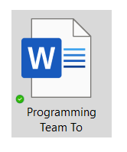
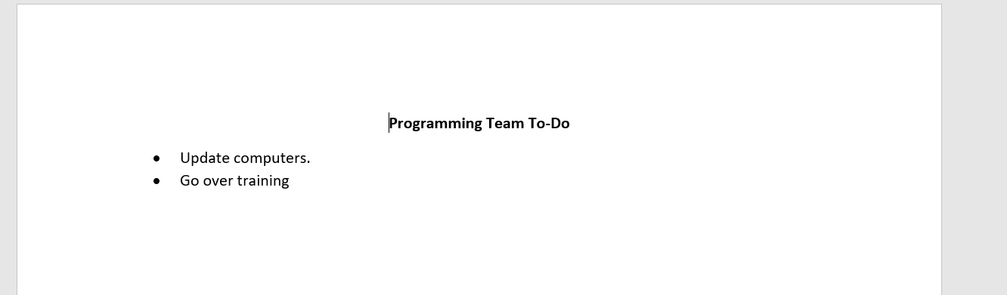
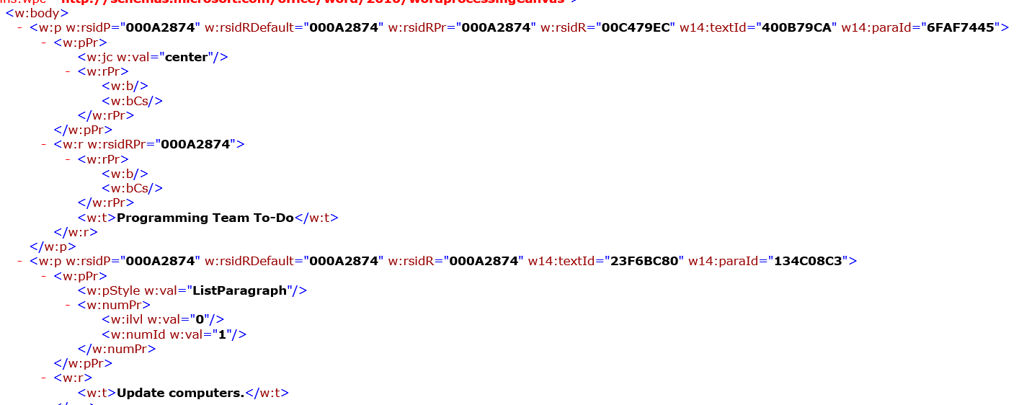
Abstraction
Have you worked with a Microsoft Word .docx file before?
It is not actually a file, it is a folder of multiple XML text files in a .ZIP archive. You can unzip the file and all your text is in the file word/document.xml
This is an abstraction. You interact with the .docx file as it if was a single file. Most people don’t even know the xml text file exists.

Slide 15
Thoughts on using C++ with FRC
Building a basic project with an Arduino and coding it is relatively straight forward. Doing the same thing with C++ and a RoboRio is very complicated. FRC C++ programing is the way stuff in the ‘real world’ is programed…it is not a simplified framework for high school students.
It’s kind of like the difference between using a hand saw vs. walking into a complete machine shop. If you want to be a machinist, you need to know how to use more than just a hand saw.
Other sub teams generally deal with concrete problems (how do I mount this lever to the chassis?). The programing team deals with abstract problems (should I instantiate a subsystem within the definition of a command?).
Concrete problems are much easier to conceptualize than abstract problems. In other words, dealing in the abstract is hard. Abstraction can be very powerful, but I didn’t really appreciate this until my third year in college studying engineering. Prior to that, I just found all the abstraction needlessly confusing.
The answer to the question above is “no”. You don’t want to instantiate a subsystem from the definition of a command. It will produce unexpected behavior of the subsystem. You should instantiate it in RobotContainer and pass it by reference to the command. By the end of this presentation, you should have a better understanding why.
If concepts like abstraction and scalability are confusing, don’t worry about it. Just know that even though you would think that there could be easier ways to program a robot, there are reasons why the robot is programmed the way it is programmed.

Slide 16
Terminology
I try to use correct C++ terminology in the presentation.
If you want to learn more, it is easer to search the web for “can you instantiate an object and pass it to a function as an argument without naming it” than “why does m_drive.SetDefaultCommand(DefaultDrive(&m_drive, [this] { return m_driverController.GetY(frc::GenericHID::kLeftHand);}, [this] { return m_driverController.GetX(frc::GenericHID::kRightHand); })); work?”
Often there is more than one correct way to describe things when talking about C++.
Method is another name for member function.
An object is instantiated when it is constructed.
A class that inherits from another class can be called a subclass, but it is also a class in its own right.
Variables have of a type such as int, objects have a class which can also be referred to as a type.

Slide 17
VS Code C++ Intellisense
Intellisense understands your code and will alert you to problems (with red squiggle underlines).
Intellisense is helpful to understand what different parts of the code do (see next slide).
If Intellisense isn’t working:
Make sure the C++ intellisense extension is installed and refreshed from the WPILib menu.
Make sure you open the correct folder when you first open the project (the root project folder you clone from GitHub).
If intellisense is not working on header files, this is a known bug. Search the FRC documentation for the work around to get intellisense functioning again.

Slide 18
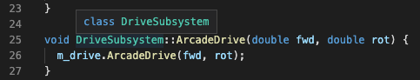
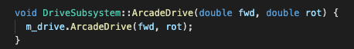
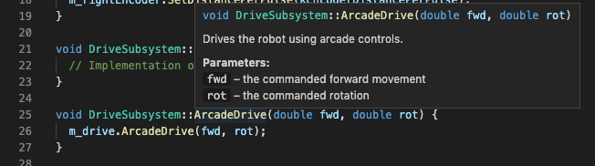
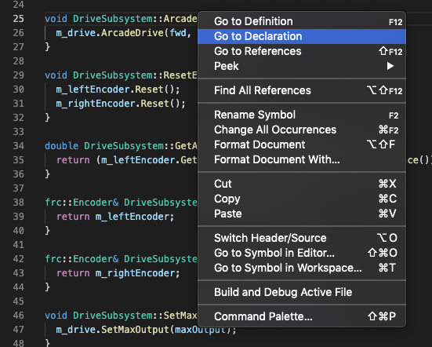
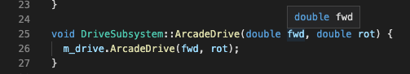
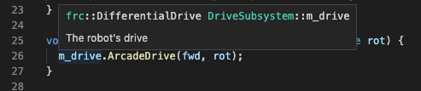
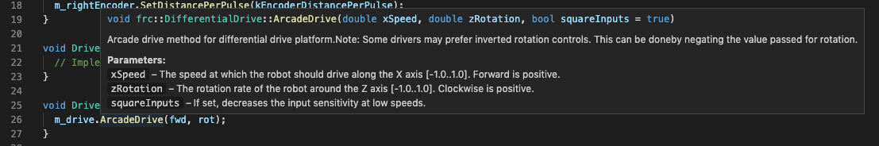
Color Code
Built in type
(aka Fundamental type)
Hover
Class
Function
Object or Variable
Class name
Function including return type, full scope and required arguments. Any comments above the function declaration are displayed as well as they are assumed to provide instructions for the use of the function.
Right Click Menu
Variable including fundamental type and name.
Full scope of the object’s class and name.
Note: It is now clear this ArcadeDrive member function is completely different from the one above. They are in different scopes and this one takes an optional bool argument.
Viewing the declaration of an object or function from the WPI Library in the WPI Library code is sometimes more helpful than the online documentation. You can also look for definitions as well as every use of an object or function.

Slide 19
Example with actual C++ Code
I will start with the “traditional hatchbot” example provided by FRC here: https://github.com/wpilibsuite/allwpilib/tree/master/wpilibcExamples/src/main/cpp/examples/HatchbotTraditional
The FCR examples are pedagogical. That means they are teaching examples. An actual robot program would need a lot more features to be useful in a competition.

Slide 20
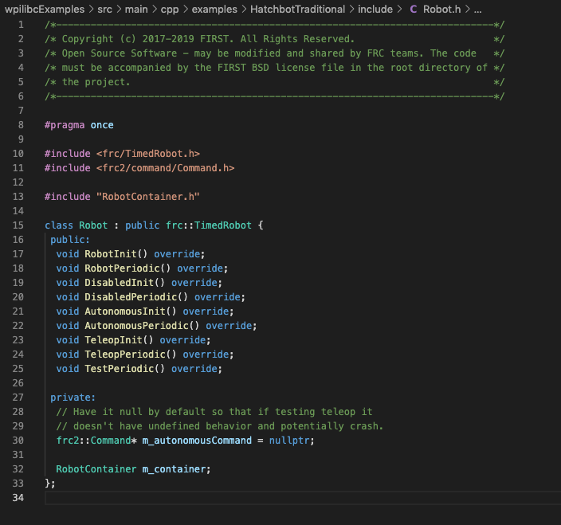
Precompiler directive: Do not send more than one version of this file to the compiler. If you did, defining the same class twice would create an error.
The Robot subclass inherits from the frc::TimedRobot class.
Public member function declarations. They are void because they don’t return anything, they just do stuff. override ensure the member functions are always virtual. This means when a Robot object’s member function is called, we need to make sure it is our definition of Robot.RobotInit() and not the inherited frc::TimedRobot.RobotInt() function that is called.
When a Robot object is instantiated, a private member variable of type ‘pointer to a frc2::Command object is created, named m_autonomousCommand, and is set to the null pointer by default. If it is not set to anything and autonomous mode is executed, the RoboRio will start executing code from some random spot in memory.
Instantiated objects are named m_. Things like the RobotContainer should only be declared one time in one file. Be careful about this.
When a Robot object is instantiated, a private member object of type RobotContainer named m_container is created.

Slide 21
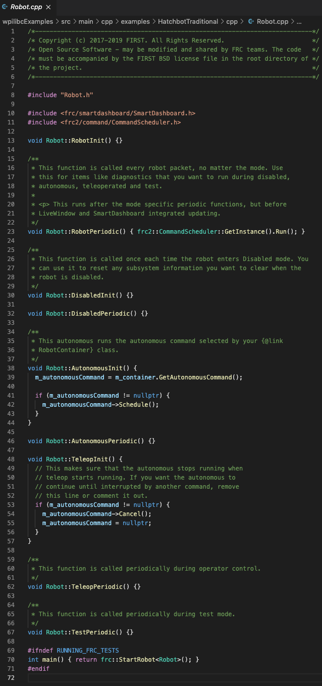
This precompiler directive includes the header file (previous slide) as if all the code was typed right here. The complier doesn’t know the difference.
The classes (including declaration of member functions) should be defined in the header file. The C++ files includes the implementation of what the member functions do. Keeping things sperate like this makes it easier to manage complex programs.
Any system wide code you want executed one time when the robot starts up should go inside the {}.
The ”behind the scenes code” of a Robot object executes the RobotPeriodic() function every 20ms. Every 20ms, the frc2::CommandScheduler::GetInstance() function is run and returns the robot’s CommandScheduler instance. The Run() member function of the instance is then executed which goes through an iteration of the command scheduler. The syntax involves chaining (see next slide).
Sets m_autonomousCommand pointer to the memory location of the autonomous command returned by the GetAutonomousCommand member function of the RobotContainer class (which gets it from the SendableChooser).
If the pointer to the command points to an actual spot in memory, then schedule it via the frc2::command.Schedule() inherited member function (member function of the thing pointed to, not of the pointer itself). See following slide.
Precompiler directive to send the text between #ifndef and #endif to the compiler if the global variable RUNNING_FRC_TESTS has has not been defined. Normally it is not defined.
This is the main(){} function where execution begins. Basically it calls a function that gets all the “behind the scenes” code of the WPI Libraries going and instantiates a Robot object which then instantiates a RobotContainer object (m_container) and a pointer to an autonomous command (m_autonomousCommand)
main() calls the frc::StartRobot function with a template parameter of type Robot. It returns an integer (probably and error code of why the program stopped). Templating allows code to be written without specifying the type of an object ahead of time. When the code is complied, it is complied based on the type that is passed as a template argument.

Slide 22
Member function Chaining
Imagine I create a class Math with member functions Double, Triple and Half defined like this:
Int Triple(Int X){return X*X*X;}
You could write code like this:
a = Math.Half(20);
b = Math.Tripple(a);
c = Math.Double(b);
cout << “c = “ << c;
Or you could chain the member functions like this:
Math.Half(20).Tripple.Double;
cout << “c = “ << c;
Both options cause the computer to do the same thing.
To chain, all the functions need to be members of the same class and the type a function returns needs to match the type the next member function expects as an argument.
Execution is from left to right.

Slide 23
Member function Chaining
Code from Robot.cpp frc2::CommandScheduler::GetInstance().Run() is an example of member function chaining.
frc2::CommandScheduler::GetInstance() returns a CommandScheduler object (actually a pointer to the object in question).
Execution is from left to right.
In the second step the code reduces to ReturnedObject.Run() which executes the Run() member function of the object returned by the code to the left of it.
You can chain as may commands as you like as long as they are all member functions of the same class and the functions return an object of the same class they were called with.

Slide 24
Class->function notation
Code from Robot.cpp m_autonomousCommand->Schedule() means using the Schedule member function of the thing the m_autonomousCommand pointer points to.
*m_autonomousCommand.Schedule() doesn’t work because the . is evaluated before the * and is the same as *(m_autonomousCommand.Schedule()) and the pointer itself doesn’t have a member function.
You need to type (*m_autonomousCommand).Schedule() to access the member function of the thing that is pointed to.
In C++, m_autonomousCommand->Schedule() means the same thing and is easier to type/read.

Slide 25
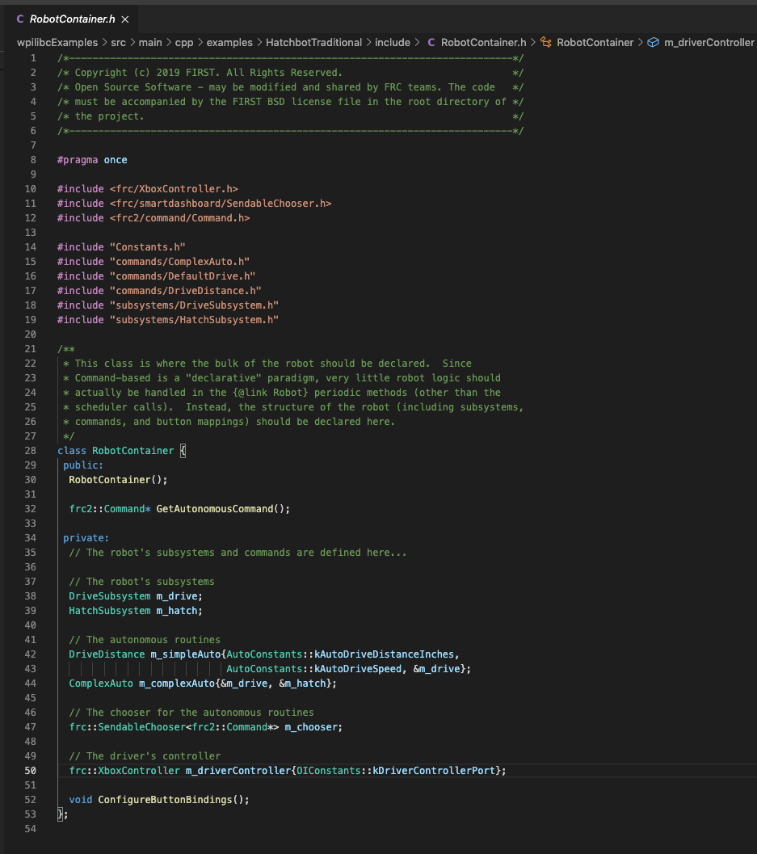
A member function with the same name as the class is a constructor. The constructor controls how an object is instantiated (or you can say constructed). This is a declaration that RobotContainer has a constructor. If no constructor is defined, a default constructor is implemented by the compiler. The function does not need to be declared void because constructors can’t return anything.
All subsystems and commands are declared private so only RobotContainer objects (and only one gets instantiated) can interact with them. This is where (and the only place where) the command objects are ‘wired’ to the subsystem objects.
When the RobotContainer object is instantiated, all the subsystems and commands are instantiated according their own class definitions (other files we’ll get to). This declaration, for example, allocates the memory for a DriveSbusystem object named m_drive.
The subsystem objects are only instantiated once in the code. References are used everywhere else. If you instantiate multiple subsystem objects they can both try to control the subsystem at the same time…and that would not be good.
An object of type DriveDistance named m_simpleAuto is being declared. The declaration includes three arguments that will be passed to the constructor of the DriveDistance object when it is instantiated. AutoConstants::kAutoDriveDistanceInches and AutoConstants::kAutoDriveSpeed are just numbers. They are all defined in the Constants.h file to avoid having “magic numbers” in the code here. Note the convention that they are named starting with a k. &m_drive is a reference to the DriveSubsystem object declared above. You give a command access to a subsystem by passing it by reference to the command’s constructor.
This ComplexAuto object is constructed with access to both the m_drive and m_hatch subsystem objects. To prevent two commands from issuing commands to a subsystem at the same time, the WPI Libraries create a Command Scheduler that is always running and makes sure only one command object can control a subsystem object at any give time. This works as long as you only instantiate each subsystem once.
This declares the SendableChooser object m_chooser with a template argument of type frc2::command. You can create multiple autonomous routines (commands). The Sendable Chooser lets you select on the driver’s station which auto routine you want to run right before the match starts.

Slide 26
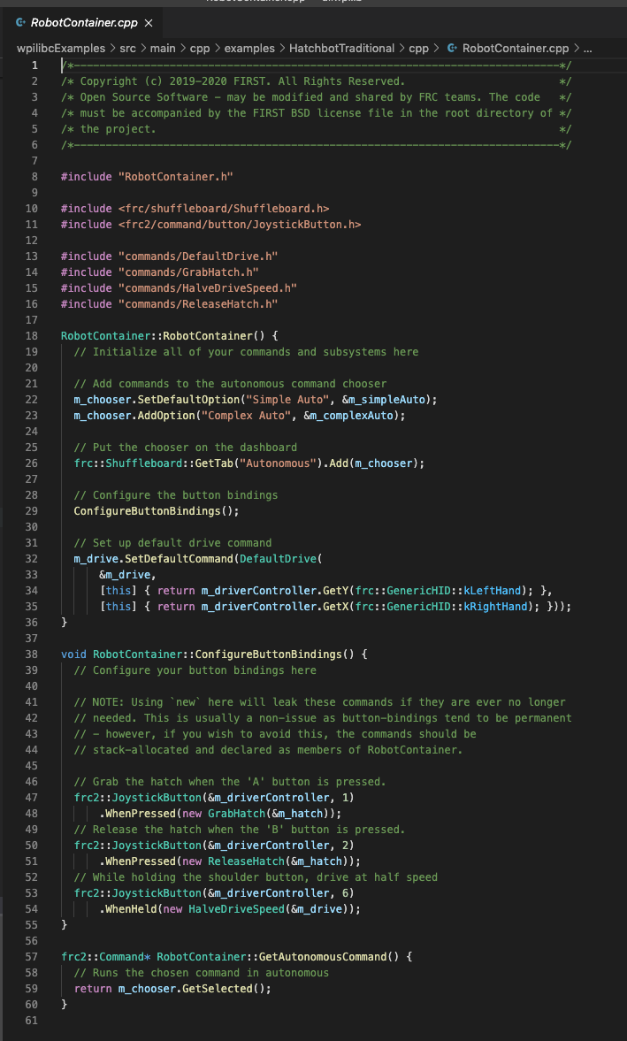
This is the function definition for the constructor for a RobotContainer object.
These member functions of the SendableChooser class get the text to show up on the driver station screen and link them to the autonomous routine objects by reference.
This function is declared in the constructor deffinition but defined outside the constructor.
m_drive is a DriveSubsystem object. The class inherits from the frc2::SubsystemBase class which allows any subsystem to have a default command that is always running when no other command is scheduled. In this case, you schedule the DefaultDrive command so you can drive the robot any time no other command is driving it.
DefaultDrive objects are instantiated with three arguments being passed to the constructor: a reference to a DriveSubsystem object and two function objects. It is important that the second two objects are functions and not the double returned by the functions. If this is not done correctly, the DefaultDrive object would be constructed with the X and Y values at instantiation and would not respond the to current X and Y values of the joystick.
When the RobotContainer object is instantiated, a ConfigureButtonBindings() function is created. These declarations of frc2::JoystickButton objects and their member functions are what ‘wire’ specific joystick actions to specific commands. The objects are instantiated with a reference to a controller and a button number (note the unfortunate use of ‘magic numbers’). The member functions such as WhenPressed are executed with a heap allocated command object that itself is instantiated with a reference to the required subsystem as an argument. Note that the GrabHatch command object is declared and passed along as an argument to a function without being named.
The GetAutonomousCommand() member function of the RobotContainer object executes the GetSlected() member function of the SandableChososer object m_chooser and returns a pointer to the autonomous command selected.

Slide 27
Lambda functions
Normally object classes are declared, defined and then objects are instantiated.
In coding, an object class that is defined right where it is used (without being given a name) is called a lambda function.
In C++, the syntax is [capture_list](arguments){code}
An object has no access to functions in the surrounding scope unless passed to it. The [capture_list] specifies what the lambda function should have access to. The this pointer gives the lambda access to all the other members of the class where it is used.
The (arguments) list are the arguments to the lambda and can be omitted completely if not used.
{code} is where you put the code of the lambda function. Remember each line of code must end with a semicolon.

Slide 28
Lambda functions (example)
In RobotContainer.cpp a DefaultDrive object is instantiated using the lambda [this] { return m_driverController.GetY(frc::GenericHID::kLeftHand);} as an argument.
[this] captures the RobotContainer objects including the m_driveController object so the lambda has access to it. (In other words, which m_driveController am I talking about? this one. The one that is currently in scope.)
() is omitted as there are no arguments passed to the lambda.
The {function} returns the current Y value of the left hand joy stick.
Note that frc::GenericHID::kLeftHand is an enumeration with a value of 0. You could just type the number 0, but the code is easier to read because you describe the meaning of the number and the actual enumeration is defined where controllers are described (in the frc::GenericHID class).

Slide 29
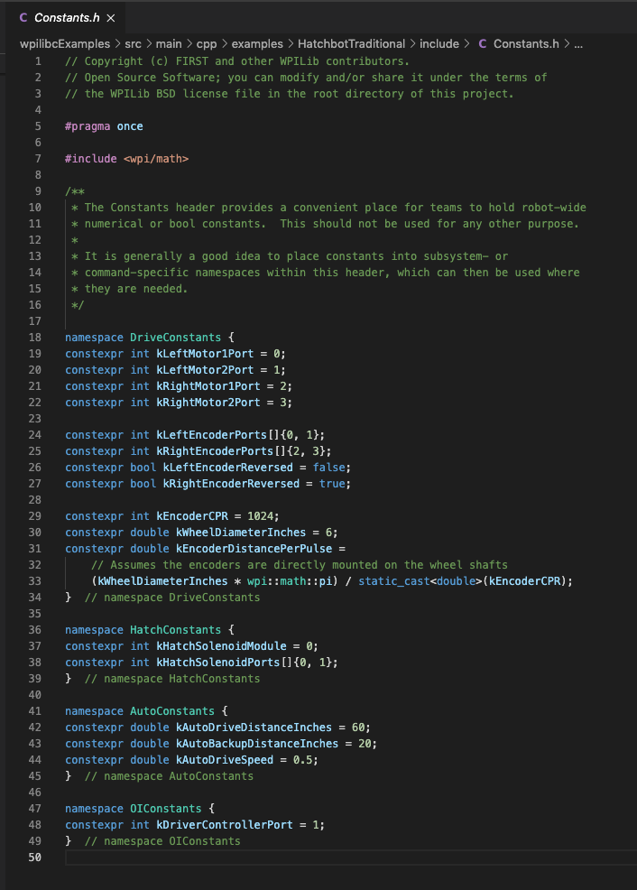
You can always type constant numbers directly into the code where you need them but this is considered bad practice. It is much better to create descriptive names and then define them all in one place. This makes it easier for other people to understand how your code works and there is always a single place to go when a constant needs to be updated. Numbers simply typed directly into the code are often derisively called “magic numbers”.
Doing it this way avoids having to type out things like DriveConstants::kLeftMotor1Port each time.
constexpr means you intend the variable to be a constant and should never change. If you later try to write a new value to the variable, the complier will throw an error.
This where you can keep track of which motors are wired to which ports on the robioRio.
You could also write this kLeftEncoderPorts[2]{0,1} but the 2 is not necessary as the complier defaults to creating an array to match the number of items being declared.
kEncoderCPR is an int but everything else is a double. static_cast<double>(kEncoderCPR) is needed to convert (i.e cast) kEncoderCPR to a double so you can divide another double by it.

Slide 30
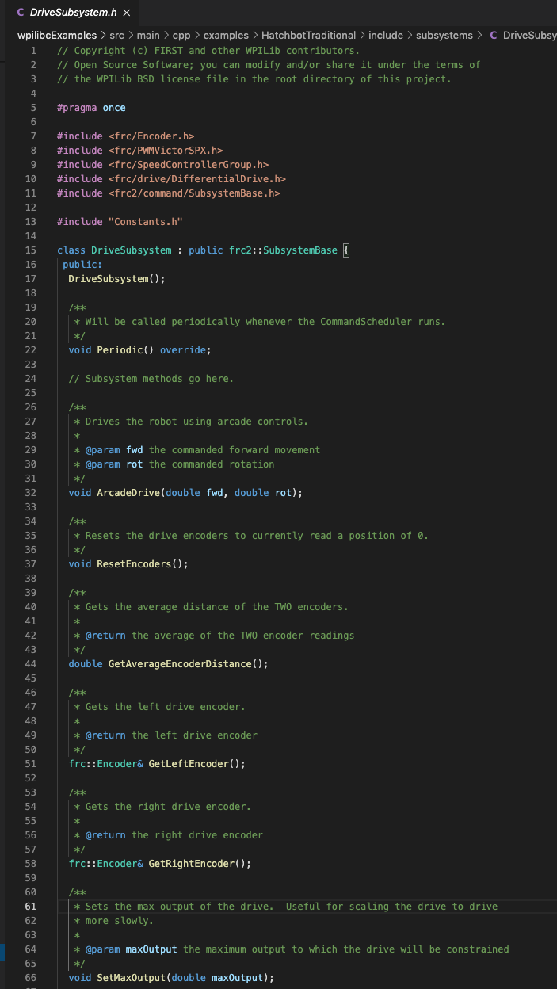
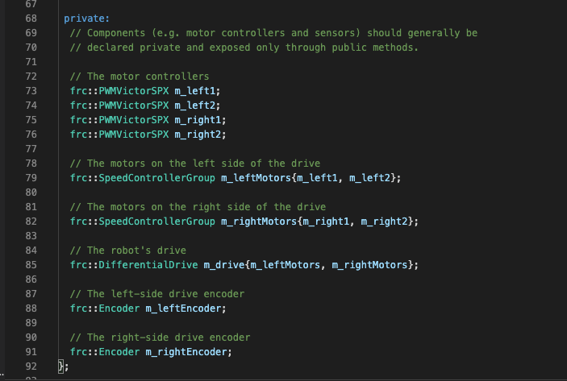
Subsystems are subclassed from from the frc2::SubsystemBase class and that is how they get most of their useful member functions.
Everything from the encoders to the motor controllers are declared private. When a DriveSubsystem object is instantiated, only its member function can access the private objects. This is an example of separating the interface (stuff declared public) from the implementation (stuff declared private). This is an example of abstraction. Other parts of the program don’t need to know how the drive subsystem works, they just need to know how you tell it how to move. You do this by calling the ArcadeDrive member function with the forward and rotational speed as arguments of type double. Another way of looking at this is that only a subsystem’s member functions can tell the motors what to do. Nobody else should be able to tell the motors what to do, they can only tell the subsystem what forward and rotational speed to drive with and the subsystem will decide what to tell the motors to do. Remember, there should only be one DriveSubsystem object instantiated in the code (RobotContainer::m_drive).
This part is just a comment but VSCode displays it it as function documentation anytime you hover over an ArcadeDrive function. The @pram syntax identifies documentation of function parameters to VS Code.
Declares member function ArcadeDrive that takes forward and rotational speed as arguments.
Declaration of motor controller objects
Declaration of SpeedControllerGroup object with left side motor controller objects passed as arguments to its constructor.
Declaration of DifferentialDrive object with
SpeedControllerGroup objects passed as arguments to its constructor.
Declaration of Subsystem Encoders

Slide 31
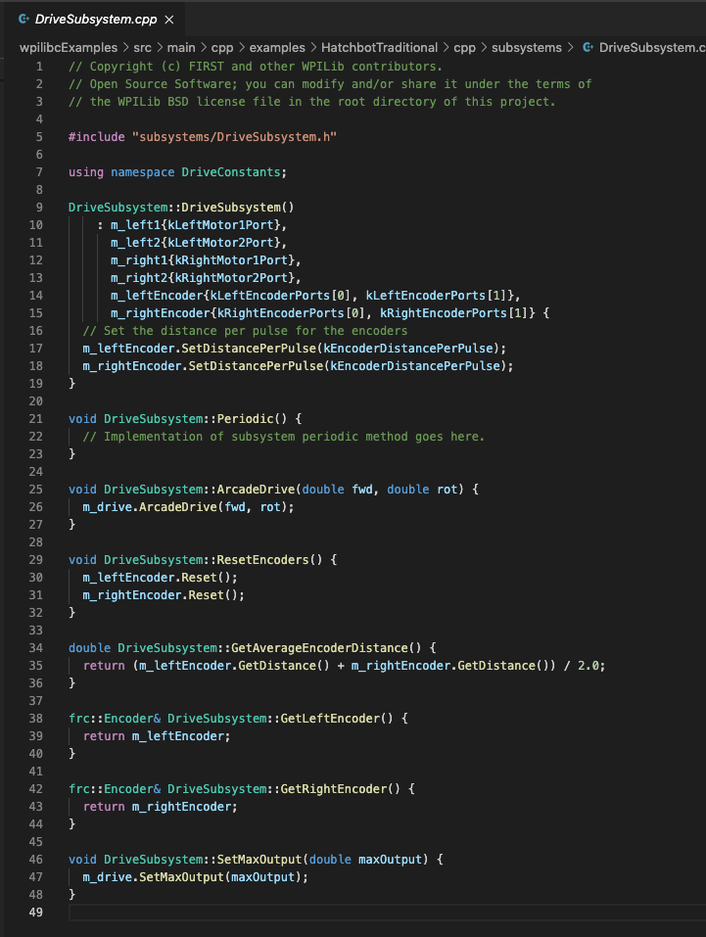
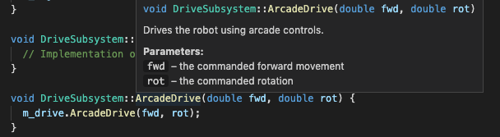
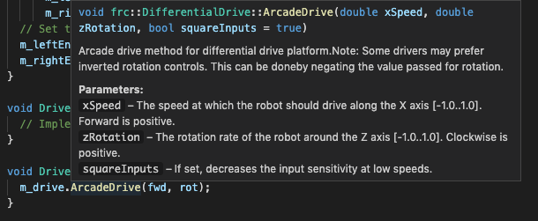
Most subsystem objects work by defining a public member function that takes takes arguments (if required) and passes them to a member function of a private object that inherits from an frc object such a DifferentialDrive, DoubleSolenoid, etc.
Constants from the DriveConstants namespace can now be used anywhere in this file without the need for the scope resolution operator.
There is a bunch of code on lines 10-15 (stating with a colon) between DriveSubsystem::DriveSubsystem() and the final open brace at the end of line 15 where the scope of the constructor function begins. The code tells the compiler arguments to use when constructing the new objects that are part of a new DriveSubsystem object being instantiated. In this case, the the encoder and motor controller objects are being instantiated with an argument of what port number of the roboRio the actual physical devices are wired up to.
Most of the subsystem coding is declaring objects or defining member functions that pass values back and fourth from the subsystem member functions to the built in member functions of objects from the frc:: classes. If you have something that requires continuous calculations, you can define it here and it will automatically get executed every 20 ms.
This is the implementation of the ArcadeDrive member function of a DriveSubsystem object. It simply passes the forward and rotational speed to the m_drive.ArcadeDrive function which is frc::DifferentialDrive::ArcadeDrive since m_drive is an object of class frc::DifferentialDrive. It is important to understand the two ArcadeDrive member functions are completely different and just happen to be called the same thing. You can tell they are different by hovering over them in VS Code as seen below.

Slide 32
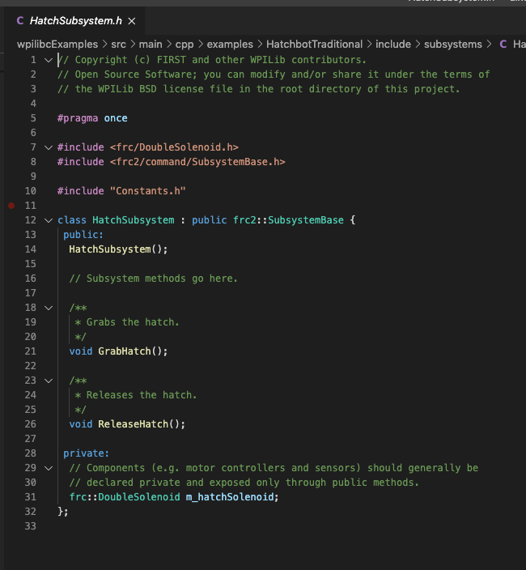
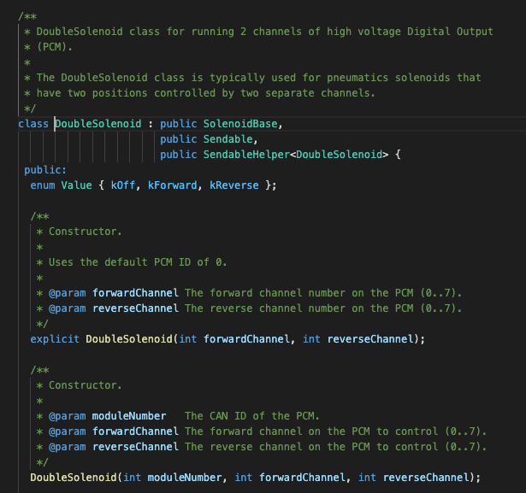
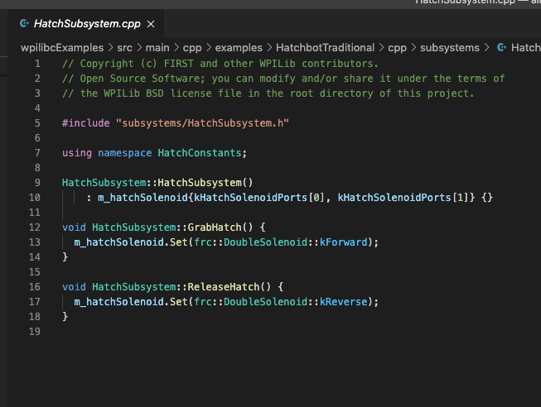
DoubleSolenoid.h
frc::DoubleSolenoid constructors. The first constructor is declared explicit which means it will only work if it is passed exactly two arguments of type int. The second version of the constructor will accept three arguments and is used if the solenoid is connected to the can bus instead of the DO ports of the roboRio. This is an example of an overload where different versions of a function are executed based on which types of arguments are passed to the function.
Declaration of an enumeration.
frc::DoubleSolenoid object m_hatchSolenoid is declared.
The HatchSubsystem constructor instantiates the m_hatchSolenoid object object that is part of the class by passing two arguments to the constructor of a frc::DoubleSolenoid object. You can look up what the arguments should be in the WIPLib documentation. You can also right click on frc::DoubleSolenoid and select Go to Definition. This takes you to the code in the WPI Library. See above right.
The public member functions of a HatchSubsystem object are defined to grab and release a hatch by executing the frc::DoubleSolenoid.set() member function of the m_hatchSolenoid object. The function argument is type enum (an enumeration). An enumeration is a list of possible options that can be used (kind of like a drop down list on a website). The enum is defined just before the constructors in DoubleSolenoid.h shown above right.

Slide 33
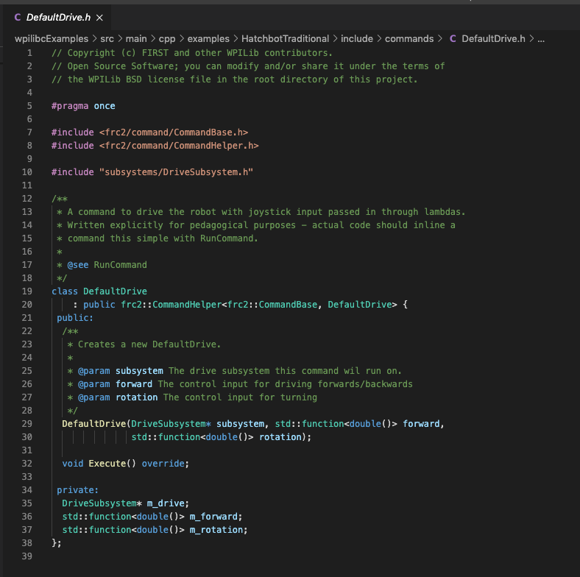
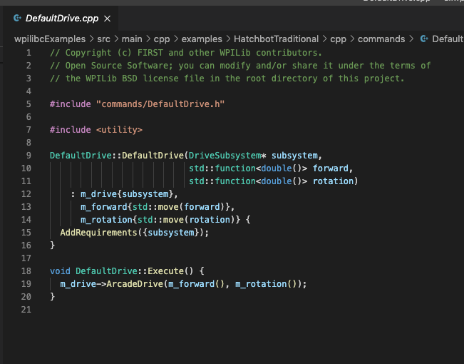
Note that the DefaultDrive class inherits from frc::CommandHelper<frc2::Commandbase, DefaultDrive> class. This is a template class where the actual types of objects used to create the class are supplied during instantiation. In this case, the template class accepts two arguments and is supplied the classes frc2::CommandBase and DefulatDrive. This is an example of a Curiously Recurring Template Pattern (CRTP) where a class inherits from itself through a template class. This is done to allow decorator functions to work (see next slide). If this is confusing, don’t worry about it. Just remember command classes need to be declared to inherit from themselves.
In RobotContainer.cpp, an (unnamed) DefaultDrive object is instantiated and sent to the DriveSubsystem object’s SetDefualtCommand member function. This causes the command scheduler to execute DefualtDrive::Execute() when ever no other command needs the DriveSubsystem. It is important it note that only one DriveSubsytem object (RobotContainer::m_drive) is instantiated in all the code. RobotContainer::m_drive is private to a RobotCoontainer object so commands cannot access it directly. A reference to RobotContainer::m_drive is passed to the DefaultDrive constructor when it is instantiated in RobotContiner.cpp. This is how a command talks to its subsystem.
The constructor function is declared to take three arguments. The type and public name of each object is declared.
m_drive is declared private, type pointer to a DriveSubsystem object.
m_forward is declared private, type “a function that takes no arguments and returns a double”.
Private objects of a DefualtDrive object will be instantiated with the objects passed to the constructor as arguments. std::move ensures the function is cast to an lvalue and moved instead of being copied. See frc documentation for lvalue/rvalue explanation if you want the details.
The body of the constructor function adds the subsystem as a requirement to execute the command. The command scheduler needs to know this so two commands aren’t allowed to try to command the the same subsystem at the same time.
DefaultDrive::Execute() sends the functions for forward and rotational speed to the ArcadeDrive member function of the subsystem that m_drive points to.

Slide 34
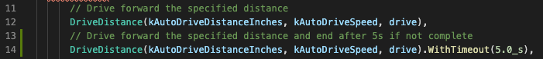
Command Decorator functions
Command class objects inherit a number of decorator member functions.
They take an object and return an object of the same type that has added functionality.
In the example below, the second version of the command has the added functionality that it will be interrupted if not finished after 5 seconds.

Slide 35
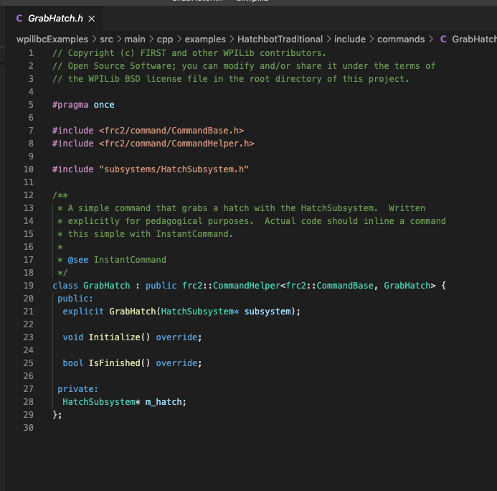
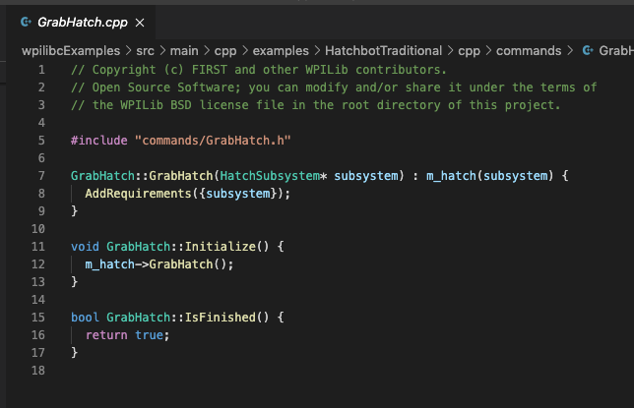
Note this comment. We will later look at the Hatchbotinlind example project where all commands are defined in their code where they are used and only one command class is declared for the project. There is better way to do this for very simple commands like this. All this command does is fire a solenoid when executed (and presumably close a claw that grabs a hatch panel).
Subsystem objects are declared private so command objects must be constructed with a reference to the subsystems they require. This is known as dependency injection and is considered a best practice in object oriented programming. It makes it easier for other parts of the library code to know who is requesting use of a subsystem and if they still need it. The other option is to declare subsystem public but then everyone always has access to them and the programmer must make sure no competing request are made.
When command scheduler runs this command it will (1) run the Initialize() member function which activates the solenoid (2) run the Execute() member function (there isn’t one) (3) run the IsFinished() member function to see if the command thinks it is done and learn the command says it’s done. That’s it.

Slide 36
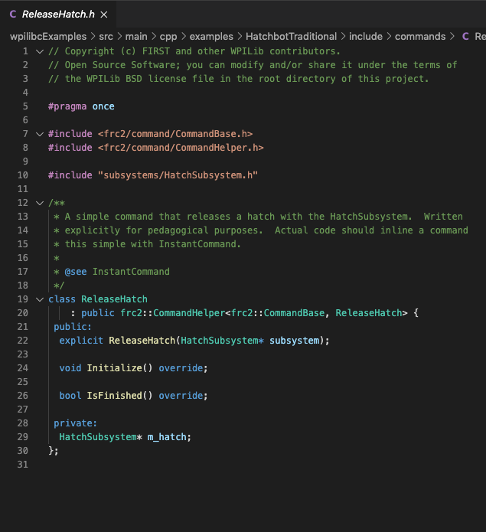
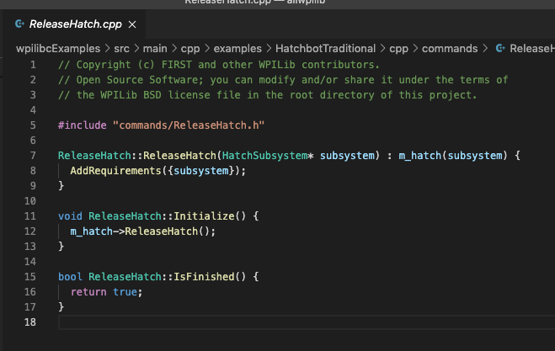
Exactly the same as the GrabHatch class except it executes *HatchSubsystem->ReleaseHatch() instead of *HatchSubsystem->GrabHatch().

Slide 37
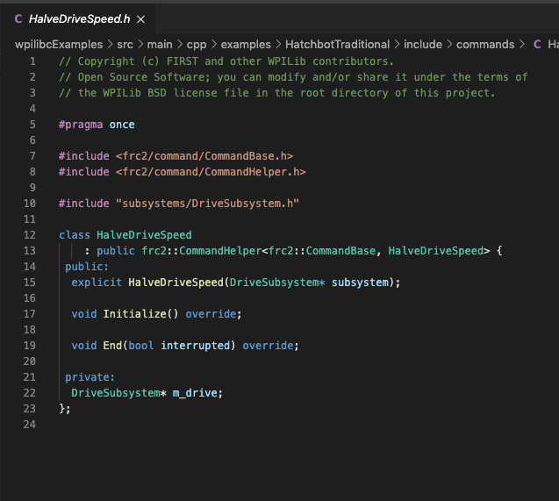
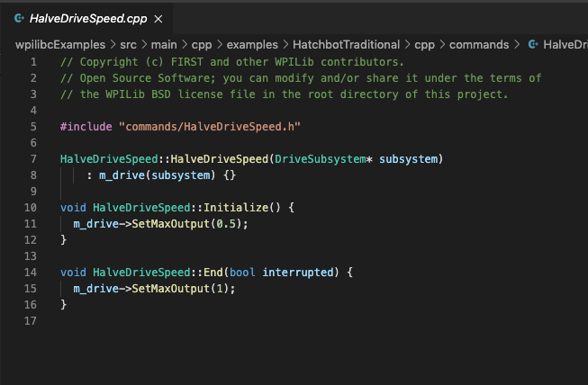
When the command is scheduled, its Initialize() member function executes the SetMaxOutput member function of the referenced DriveSubsystem object with an argument of 0.5. If you go back to DriveSubsystem.cpp, the DriveSybsystem::SetMaxOutput member function passes the argument to the frc::DifferentialDrive::SetMaxOutput() member function of the frc::DifferentialDrive object declared in the DriveSubsystem class. The frc::DifferentialDrive class inherits from the abstract class frc::RobotDriveBase which is where the frc::DifferentialDrive::SetMaxOuput() function is actually declared (and where it shows up in the WPILib documentation).
When the function is executed with an argument of 0.5, it causes the robot drive to run at 50% of the requested speed.
When the command scheduler ends execution of the command, the last thing it does is call the End() member function of the command class. In this case, the End() command sets the drive back to 100% of requested speed.
Note that the function is defined to take a bool argument. If the the Command Scheduler ends the command because it reports it is finished through the IsFinsihed() member function, it calls End(false). If the Command Scheduler ends the command because it is interrupted it calls End(true). In this case, HalveDriveSpeed::End(bool) does not do anything with the bool value.

Slide 38
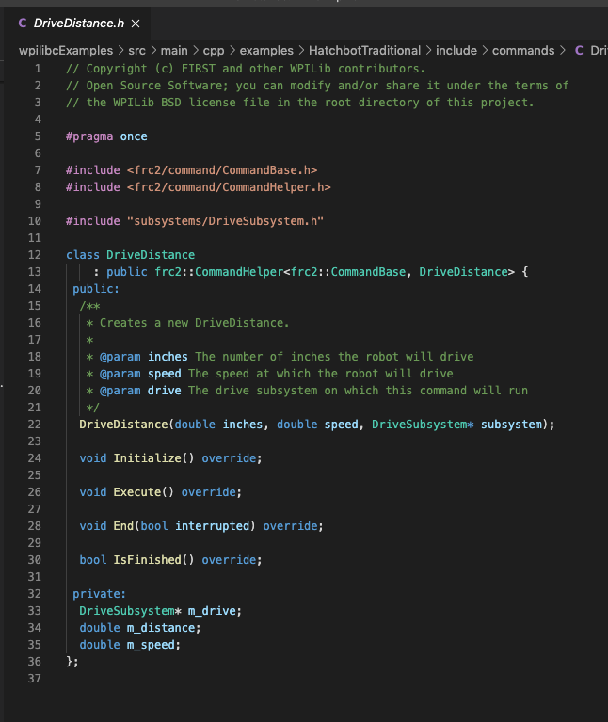
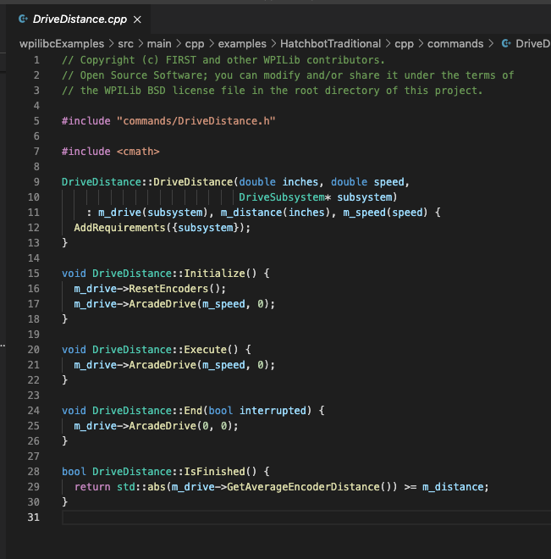
This is:
DriveSubsystem* DriveDistance::m_drive
We have also seen:
Drive Subsystem RobotContainer::m_drive
frc::DifferentialDrive DriveSubsystem::m_drive
DriveSubsystem* DefualtDrive::m_drive
DriveSubsystem* HalveDriveSpeed::m_drive
They are all different objects of one of three different types and they can all be called m_drive because they are in different scopes. The only reason they are all called m_drive is because they all refer to similar concepts and that makes it easier from humans to get a sense for how the code works.
When the command is first scheduled, the encoders are reset and the DriveSubsystem object that is pointed to is requested to go forward with m_speed speed and 0 turning speed.
The command scheduler calls IsFinished() each 20 ms to determine if the command is finished. The command returns true when finished and false when not finished. True is returned when the encoder distance >= the requested distance.

Slide 39
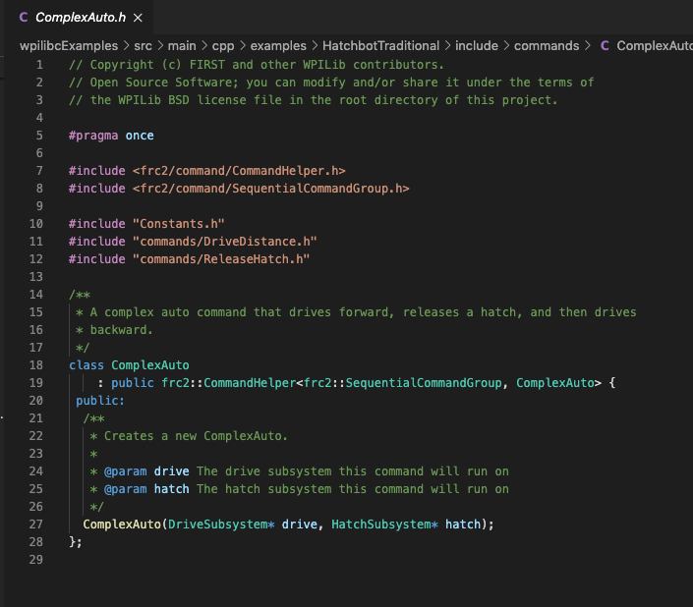
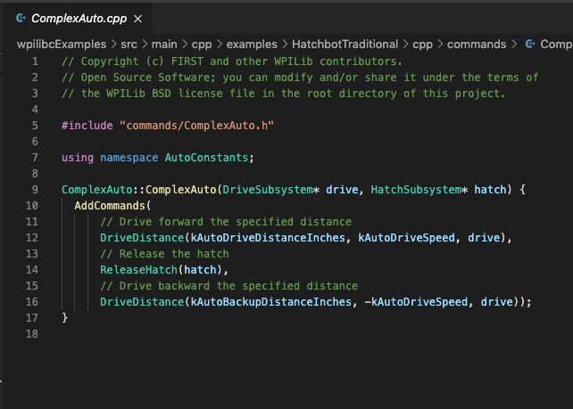
The ComplexAuto class is templated on frc2::SequentialCommandGroup instead of frc2:CommandBase. This command (and most auto commands in general) are based on adding together a sequence of individual commands.
The constructor is declared to take two arguments, a pointer to a DriveSubsystem object and a pointer to a HatchSubsystem object.
This example of a command group does the following in sequence:
Drives forward at a given speed for a given distance.
Releases the hatch
Drives backward at the same speed for the same distance.
This example uses a sequential command group. There are also classes for parallel command groups. Depending on which one you chose, the scheduler will wait for the parallel commands to complete or terminate once the first first one is finished.
The body of the constructor for a ComplexAuto object executes the inherited member function frc2::SequentialCommandGroup::AddCommands(command_1, command_2, …, last_command). The function can have any number of command objects that you want to execute sequentially as arguments. The desired settings for the commands are passed to the individual command constructors as agreements.

Slide 40
Inlined example
We will now consider the inlined version of the hatchbot located here:
https://github.com/wpilibsuite/allwpilib/tree/main/wpilibcExamples/src/main/cpp/examples/HatchbotInlined
The inlined version does the same thing as the traditional version, but it shows how simple commands can be inlined instead of declaring a new class and .h/.cpp files for each command.

Slide 41
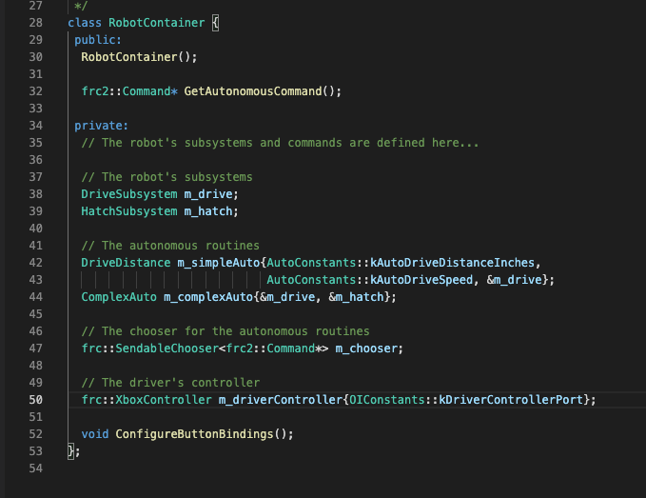
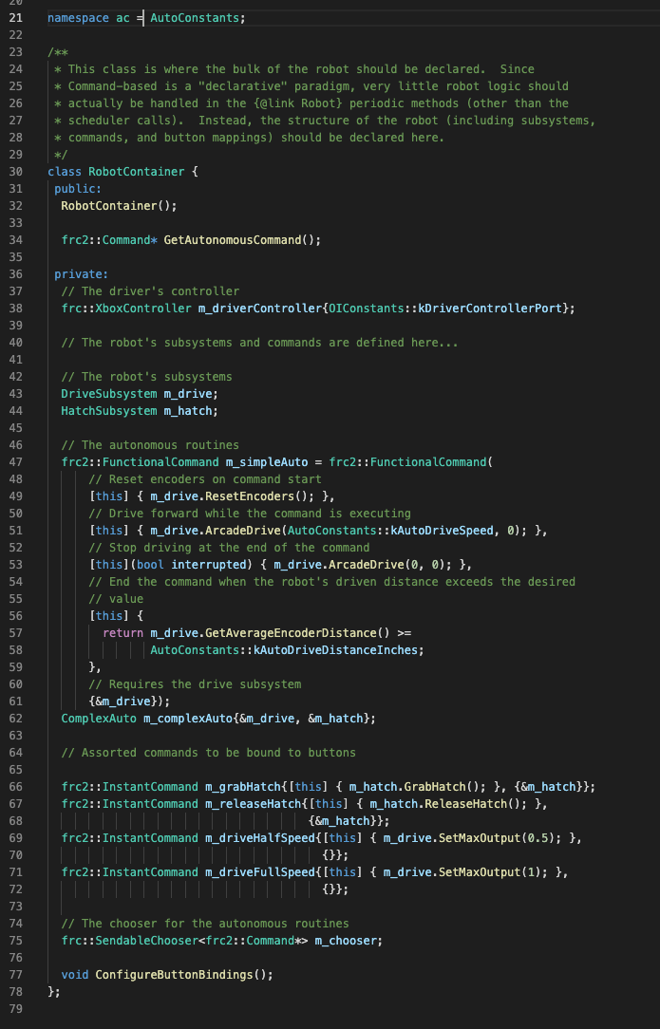
RobotContainer.h
traditional vs. inlined
m_simpleAuto is a command object of type frc2::FunctionCommand that is constructed with 5+ arguments (onInit, onExecute, onEnd, isFinsihed, requirements). This code eliminates the need for the DriveDistanc.h/cpp files in in the traditional example.
The ComplexAuto class is defined in separate .h/.cpp files just like in the traditional example.
Frc2::InstantCommand is an object class that can be constructed with a single command to be executed once, and the requires subsystem.

Slide 42
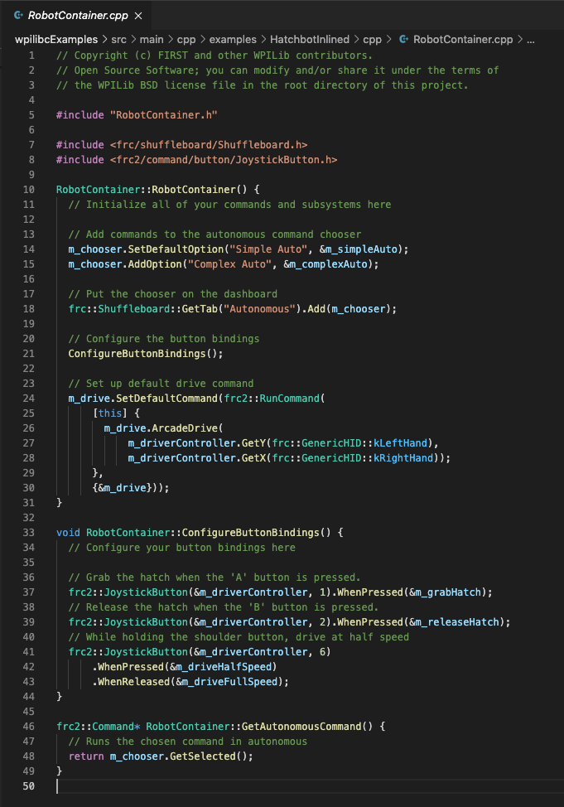
RobotContainer.cpp
traditional vs. inlined
The argument passed to the SetDefaultCommand member function of the DriveSubystem object is a frc2::RunCommand object that is constructed with a lambda expression accessing the ArcadeDrive member function of the DriveSubsystem object and a reference to the DriveSubsystem object. The frc2::RunCommand object will execute continuously as if it was declared in the Execute() member function of a subclassed command (as it is in the traditional example).
A frc2::JoystickButton object is constructed with the arguments of (reference to a controller, controller_button_number). The WhenPressed() member function has an argument of a reference to a frc2:InstantComamnd object (declared in RobotContiner.h) instead of a heap allocated instance of a subclassed command object (like in the traditional example).
The speed is set back to normal by adding a WhenReleased member function after the WhenPressed member function. This is member function chaining. In the traditional example, the speed is set back to normal with the End() member function of the HalveDriveSpeed class defined HalveDriveSpeed.cpp.
DriveSubsystem.h/.cpp &
HatchSubsystem.h/.cpp
are the same in both
traditional & inlined examples

Slide 43
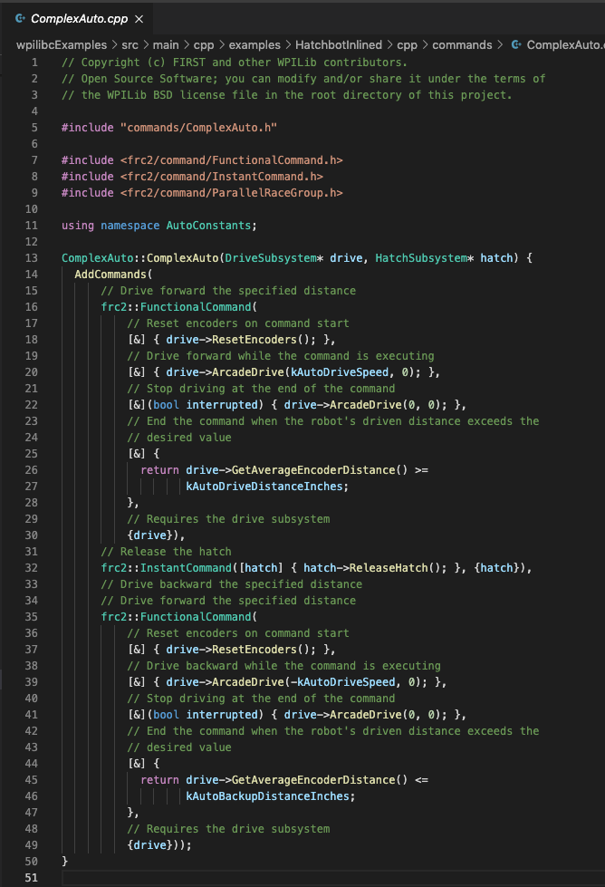
ComplexAuto.cpp
Traditional vs. Inlined
The body of the ComplexAuto constructor calls the inherited member function AddCommands which has three (command objects) as arguments. In the traditional example, they are subclassed commands. In this inlined example, they are an frc2::FunctionalCommand, an frc2::InstandCommand and an frc2::FunctionalCommand object. The functional and instant commands are constructed with individual member commands declared as lambdas and a reference the required subsystem objects.
ComplexAuto.h
is the same in both traditional & inlined examples.
The [&] capture clause of the lambdas captures all variables from the surrounding scope by reference. Specifically, drive and hatch which are local names within the constructor of the pointers to subsystems passed to the constructor when it is called.
ComplexAuto.h is the same in both traditional & inlined examples. ComplexAuto is the only subsystem class in the inlined example (because all other subsystem functionality is declared inline where it is called from).

Slide 44
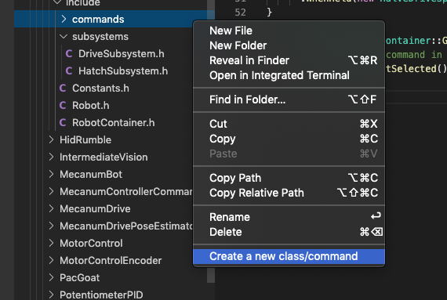
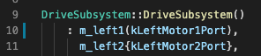
Final Notes
When it is time to create a new class of command or subsystem, right click on the folder you want it in and select Create a new class/command. Select the type of new command you want form the list that pops up enter a name for it. VS Code will create all the boiler plate code. No need to cut and paste.
The primary way information is passed between different parts of the code is as arguments. Arguments to functions are always in parenthesis. Arguments to constructers are normally in braces. But constructors are also functions so you can also use parenthesis.
I believe they normally both do the same thing but there is a subtle difference that in certain cases can matter…but I don’t really understand that part.
To me, figuring out when you were constructing an object with arguments in parenthesis vs. calling a function with the arguments was the most confusing part of understanding the code.

Slide 45
Conclusion
I am a professional Engineer, although I do not do coding as part of my job.
It took me about a year and a half of studying C++ and the FRC code before I understood it well enough to explain how a simple robot program works.
I created this training because I was not able to find this type of training anywhere and I found that even after students could write basic C++ code, they struggled (along with me) to figure out where the code should go in the robot program.
I hope others find this presentation useful.

Slide 46
Eric Haas
Team 4241 Joliet Cyborgs
eric@redoveryellow.com

